Slide 1
Leadership Matters in Reducing Disproportionate Discipline
COSA Principals & Teacher Leaders Conference
October 2015
John Lenssen

Slide 2
Key Themes
Gain background and focus for why disproportionate discipline and exclusionary practice is a priority
Changing school climate and culture
Explore key leadership skills and moves

Slide 3
What Is Discipline For?
Order Learning
Safety Fairness
Reconnection Life Skills
Moral Authority Autonomy
Teachers Students
Culture Behavior Change

Slide 4
“What Discipline is For: Connecting Students to the Benefits of Learning” Pedro Noguera
Students who are behind academically, who are more likely to be students of color, are also more likely to engage in disruptive behavior, sometimes out of frustration or embarrassment.
Children who suffer from abuse or neglect at home or who are harassed and teased by their peers are also more likely to misbehave.
Since poverty rates are higher among racial minorities in the United States, students of color are more likely to exhibit behavior problems because of unmet needs.
In many schools, it is common for the neediest students to be disciplined and for the needs driving their misbehavior to be ignored.

Slide 5
“Authentically striving for equity requires interruption of current thinking, systems, and constructs, as well as behaviors.”
Bay Area Coalitions for Equitable Schools
Notes:
4 min
1:03 – 1:07
55

Slide 6
Cultural Lens
Bias?
“Teachers carry into the classroom their personal cultural background. They perceive students, all of whom are cultural agents, with inevitable prejudice and preconception. Students likewise come to school with personal cultural backgrounds that influence their perceptions of teachers, other students, and the school itself. Together students and teachers construct, mostly without being conscious of doing it, an environment of meanings enacted in individual and group behaviors, of conflict and accommodation, rejection and acceptance, alienation and withdrawal.” (Spindler, 1994)
Notes:
66

Slide 7
Deconstructing
(Leaders facilitate these conversations)
For what behaviors do teachers refer students to …?
Why do teachers refer students to …?
What are the intended outcomes for referring students to …?
Why do schools suspend students?

Slide 8
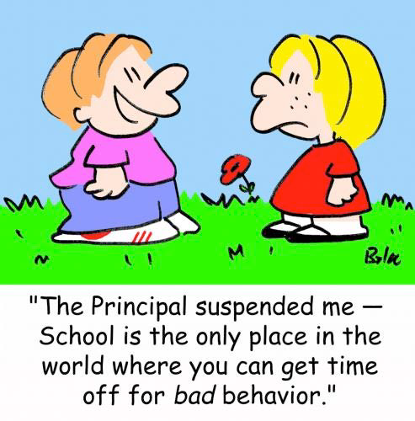

Slide 9
Exclusionary and punishment practices may appear to “work” in the short term
Remove student
Provide relief to teachers, students, administrator
Attribute responsibility for change to student and/or others (family)

Slide 10
What We Know About Exclusion
“Exposure to exclusionary discipline has been shown, not to improve school outcomes, but in fact to be associated with higher rates of school dropout.”
Skiba, Peterson and Williams,1997
Ekstrom, Goertz, Pollack, & Rock,1986
Wehlage & Rutter,1986
Sprick, Borgmeier, Nolet,(2002)

Slide 11
Russ Skiba
Center for Evaluation and Educational Policy, Indiana University
For what type of infractions are students getting suspended?
“Looking across studies of school discipline, it is clear that school suspension tends not to be reserved for serious or dangerous behaviors. The majority of offenses for which students are suspended appear to be non-violent, less-disruptive (than fighting) offenses.”

Slide 12
Big Ideas
  Office Referrals, Suspension and Expulsion from school have been used to “punish” students, alert parents, and protect other students and school staff members but there are unintended consequences
  Referrals, suspensions and expulsions may exacerbate academic deterioration
  When students are provided with no educational alternative, student alienation, delinquency, crime, and substance abuse may ensue
  Social, emotional, and mental health support for students can decrease the need for referrals, suspension and expulsion

Slide 13
Oregon Law
Limits expulsion to conduct that poses a threat to health or safety, repeated behaviors that have not responded to other interventions, and expulsions mandated by law.
Keeping students in class as much as possible in order to maximize their opportunities to learn
Creating and maintaining a positive learning environment for all students

Slide 14
U.S. Department of Education
Issues Guiding Principles: A Resource Guide for Improving School Climate and Discipline
  January 2014
Dear Colleague Letter
  Guidance letter prepared with partners at the Department of Justice describing how schools can meet their obligations under federal law to administer student discipline without discriminating on the basis of race, color, or national origin.

Slide 15
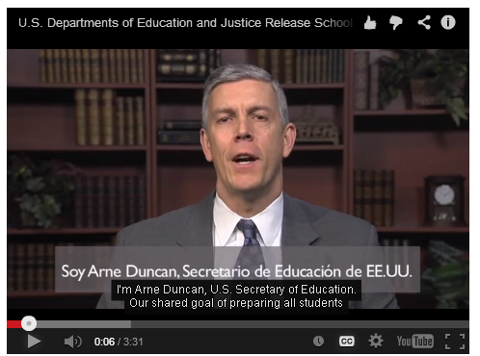
Behind the Guidance Package:
The Data
In 2011, nationwide:
  3 million out-of-school suspensions
  100,000+ students expelled
  Students lost “hundreds of thousands” of hours of instructional time
Students of color, students with disabilities are “far more likely” to be removed from class
African-American students are three times more likely to be suspended/expelled, often for similar offenses
Most exclusionary actions are for non-violent offenses
Suspensions lead to drop-outs, police contact

Slide 16
Guiding Principle 1: Climate and Prevention
(1) Engage in deliberate efforts to create positive school climates
(2) Prioritize the use of evidence-based strategies like PBIS
(3) Promote social and emotional learning to complement academic skills and encourage positive behavior
(4) Provide regular training and supports to all school personnel
(5) Collaborate with local mental health, child welfare, law enforcement, and juvenile justice agencies to align resources, prevention strategies, and intervention services
(6) Ensure that any school-based law enforcement officers’ roles focus on improving school safety and reducing inappropriate referrals to law enforcement

Slide 17
Guiding Principle 2: Clear, Appropriate, and Consistent Expectations and Consequences
(1) Set high expectations for behavior and adopt an instructional approach to school discipline.
(2) Involve families, students, and school personnel in the development and implementation of discipline policies or codes of conduct, and communicate those policies regularly and clearly.
(3) Ensure that clear, developmentally appropriate, and proportional consequences apply for misbehavior.
(4) Create policies that include appropriate procedures for students with disabilities and due process for all students.
(5) Remove students from the classroom only as a last resort, ensure that any alternative settings provide students with academic instruction, and return students to their regular class as soon as possible.

Slide 18
Guiding Principle 3: Equity and Continuous Improvement
(1) Train all school staff to apply school discipline policies, practices, and procedures in a fair and equitable manner that does not disproportionately impact students of color, students with disabilities, or other students at risk for dropout, trauma, or social exclusion.
(2) Use proactive, data-driven, and continuous efforts, including gathering feedback from families, students, teachers, and school personnel in order to prevent, identify, reduce, and eliminate discriminatory discipline and unintended consequences.

Slide 19
From What We Know About Reducing Suspension Rates for Students of Color (OLN NWREL – Nishioka 2012)
Positive, caring teacher-student relationships
High expectations for students
Structured school and classroom environments
Parental involvement
Teacher and student resources
Preventive and proactive school discipline practices

Slide 20
Schools That Reduce Disruption and Delinquency
Shared values regarding school mission and purpose (admin, staff, families, students)
Clear expectations for learning and behavior
Multiple activities designed to promote pro-social behavior and connection to school traditions
A caring social climate involving collegial and supportive relationships among adults and students
Students have valued roles and responsibilities in the school

Slide 21
A new move
  We need to address the root causes of behaviors that lead to suspension and expulsion and provide alternative disciplinary actions
  These practices might be called “restorative discipline,” adapted from the concepts and practices of “balanced and restorative justice” commonly used in juvenile and adult corrections and treatment programs.

Slide 22
Restorative Justice
Restorative Justice is an approach to dealing with conflicts that is not punitive but emphasizes accountability and reconciliation of the offender with the larger community
In schools, RJ can change discipline into a learning opportunity for students
RJ in schools is linked to a much larger RJ movement in the country

Slide 23
Critical Assumptions of RJ
Bad behavior is defined best as a violation of people, not law or rule.
Offenders should be accountable not only to authorities but to those whom they have harmed.
Victims and communities are given a direct role in seeking justice.
Justice should balance the needs of victims, offenders, communities and authorities.

Slide 24
Three Questions of Restorative Justice
Restorative Justice
  What is the harm that was done?
  How can that harm be repaired?
  Who is responsible for this repair?
Retributive Justice
  What is the law (rule or policy) that was broken?
  Who broke that law?
  How should they be punished?

Slide 25
Another Move
Implicit Bias Training
  Increase Awareness
  De-Biasing
  Focus on Situation and Context
  Change Systems and Structures
  New Skills (Practice)

Slide 26
Multidimensional View of Bias
(Kent McIntosh UO)
Racial Bias
Disproportionate Discipline
Situation
Dangerous Decision Points
Subjective Behavior Hunger
Vague Discipline System Fatigue
Prior Incidents Unfamiliar with Student
Notes:
This theory has two advantages over the unidimensional view. First, it is more predictively accurate (Jones & Nisbett, 1972; Pronin, Gilovich, & Ross, 2004). Second, it facilitates identification of solutions to seemingly intractable problems (Caplan & Nelson, 1973; Lai et al., 2013).

Slide 27
Leadership Moves
Generate Sufficient Dissatisfaction
Develop and Support Leadership Team
Make it a Priority
Commit to Measurable Outcomes
Identify What Works
Ongoing Professional Development
Resources
Monitor, Evaluate, Revise

Slide 28
Thank You!
John Lenssen and Associates
lenssenj@mindspring.com
541 905 3292

